Slide 1
Apache HTTP Server from 10,000 feet
An open source Apache feature overview and discussion

Slide 2
About the Presenter

Slide 3
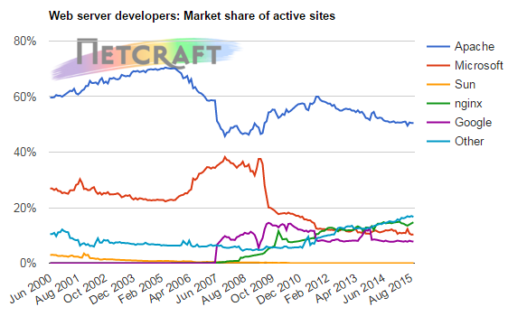
About Apache HTTP Server
Founded 1995 – built on NCSA httpd project
Open Sourced 1999 – version 1.3
Version 2 2000 – add threading, compression, and openssl support
Version 2.2 2005 - load balancing, authorization improvements
Version 2.4 2012 - event mpm, memory optimization

Slide 4
The very basics
Have a problem? Look at the Apache doc: http://httpd.apache.org/docs/2.4/
Download the newest version
YES! It works on linux and windows
Keep everything but docroot together in a custom directory, unless you’re really used to where Linux stores things
Start and stop with apachectl (easy) or httpd commands (more flexible & more than 1 apache install)
Choose a worker – Prefork (No threads, think php / perl), MPM (threaded), Event (Lots of simple traffic / keep alive)
Modules extend Apache and can be dynamically loaded – no need to compile them with Apache

Slide 5
Basic Configuration
Have your httpd.conf contain only what modules you need to start up. Generally avoid <ifmodule> and know what you’re loading
Use additional conf files for additional features, and include them at end of httpd.conf: include conf/enabled*.conf.
Files load in alpha numeric – I use enabledX00_feature.conf
Limit server information to world with ServerSignature Off ServerTokens Prod

Slide 6
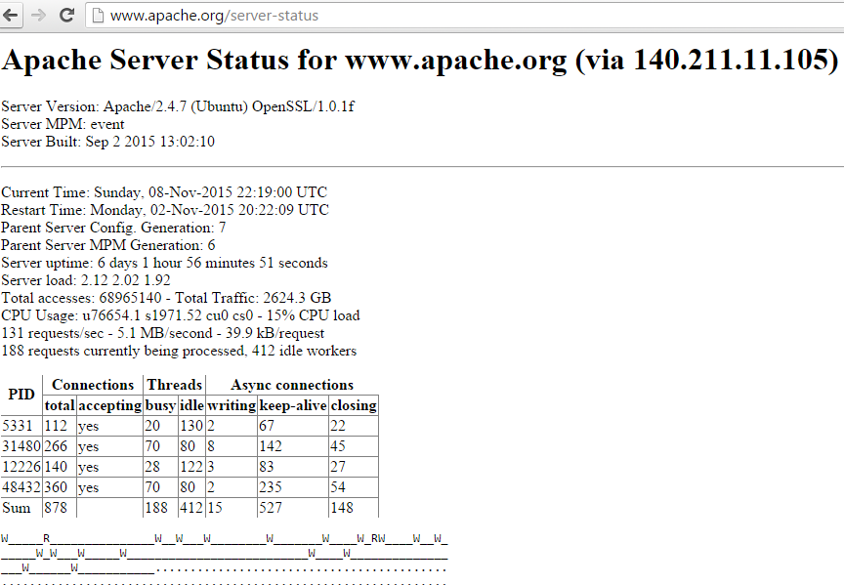
See what’s happening with mod_status

Slide 7
Understand what’s happing with logs
http://httpd.apache.org/docs/2.4/mod/mod_log_config.html
https://httpd.apache.org/docs/2.4/mod/mod_logio.html
LogFormat ("%h %l %u %t \"%r\“) (%>s) (%b) (\"%{Referer}i\“) (\"%{User-Agent}i\“) (%D) (%^FB) (%I) (%O) combined-with-IO
LogFormat (Date/Time) (request status) (total bytes) (how we got here) (browser) (total request time) (First Byte time) (Incoming bytes) (Outgoing Bytes)
Error logging, most verbose to least: traceX, debug, info, notice, warn, error, crit, alert, emerg

Slide 8
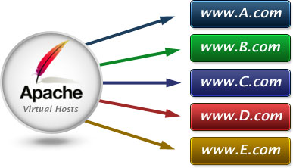
Virtual Hosting
Allows Apache to run multiple domain names and / or listen on 80 and 443
Preferred way to use SSL – SSL always requires a dedicated IP address, easily assigned in virtual host
Can generally configure each virtual host separate from master httpd.conf and other virtual hosts. Useful for log names and locations for example.
Modules inherited from other configuration files

Slide 9
Directing Traffic
Control traffic to downstream servers, such as application servers
Use mod_proxy (proxyPass) for simple traffic
Use mod_rewrite (rewriteRule) for hybrid traffic control, URI changes, and HTTP to HTTPS translation.
Use mod_proxy_balance for high availability traffic control.

Slide 10
Basic Security
Control Allow / deny access in configurations with <location> Require (all / domain / IP) (granted / denied)
.htaccess allows granular control of access and configuration by directory, but is also very slow. Ideal for distributed / multiple user / user administrator situations
Multiple forms of authentication (user/pass) available, but not generally secure. Secure via application if possible and encrypt traffic with ssl.

Slide 11
Certificates with openssl
Use newest version of Openssl – see Heartbleed, BEAST, FREAK, Poodle…. …..
Self Sign certificates for testing and personal use
Certs composed of csr (certificate signing request), key (private SSL key), .cer(certificate)
Scan your site for free for vulnerabilities and compatibility with Qualys sslabs https://www.ssllabs.com/ssltest/

Slide 12
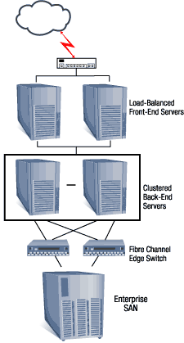
Its ALIVE! (and keeping it that way)
High availability downstream with mod_proxy_balance
http://httpd.apache.org/docs/2.4/mod/mod_proxy_balancer.html
Keep it sticky with sticky sessions
Simple active / passive Apache with keepalived with VRRP
http://www.keepalived.org/
Simple setup sample: https://raymii.org/s/tutorials/Keepalived-Simple-IP-failover-on-Ubuntu.html

Slide 13
Appendix 1 - SSL generation script
#!/usr/bin/perl -w
die "usage: autogenSSLcert.pl [certname] [open ssl ver] [sslPasskey]\n" unless ($ARGV[0] && $ARGV[1] && $ARGV[2]);
$certname = $ARGV[0]; $sslVer = $ARGV[1]; $sslPasskey = $ARGV[2];
$country="US"; $state="Maryland"; city="Silver Spring"; $org="Your Organization here";
$unit="Your subsidary / branch / etc here“ ; $email=“webmaster@yourdomain.com”;
print "Generating key for $certname\n";
system "/software/openssl/$sslVer/bin/openssl genrsa -out $certname.key 2048";
print "Generating key for $certname\n";
$cmdFileParams = "|/product/openssl/$sslVer/bin/openssl req -new -key $certname.key -out $certname.csr";
open(SSLGEN, "$cmdFileParams");
print SSLGEN "$country\n";
print SSLGEN "$state\n";
print SSLGEN "$city\n";
print SSLGEN "$org\n";
print SSLGEN "$unit\n";
print SSLGEN "$certname\n";
print SSLGEN "webmaster\@adpselect.com\n";
print SSLGEN "$sslPasskey\n";
print SSLGEN ".\n";
close (SSLGEN);
print "creating self-signed cert for $certname\n"; system "/software/openssl/$sslVer/bin/openssl x509 -req -days 3650 -in $certname.csr -signkey $certname.key -out $certname.cer";

Slide 14
Appendix 2 – Listing of config files
enabled100dont_log.conf - things I don't log, like monitoring requests
enabled200perf.conf - performance items, like mod_deflate
enabled300status.conf - status page configuration
enabled400custom_pages.conf - custom pages for 40X and 50X
enabled500cgi.conf - CGI configuration to serve perl
enabled600ssl.conf - SSL base configuration and modules
Enabled800cluster.conf – High Availability Clustering Configurations
enabled901domain1_http.conf - domain1 HTTP
enabled901domain1_ssl.conf - domain1 Ssl
enabled902domain2_http.conf - domain2 HTTP
enabled902domain2_ssl.conf - domain2 SSL
enabled903domain1_http.conf - domain3 HTTP
httpd.conf – base configuration
Magic - last resort file to help look at file and determine type
mime.types – describes file type

Slide 15
Appendix 3 – Common rewrites
# Turn On the RewriteEngine and Inherit all globally set rewrite rules
RewriteEngine on
RewriteOptions Inherit
# Only allow REQUEST_METHOD GET and POST, deny all others
RewriteCond %{REQUEST_METHOD} ^(TRACE|TRACK|DELETE|SEARCH|COPY|MOVE|PROPFIND|PROPPATCH|MKCOL|LOCK|UNLOCK|OPTIONS)
RewriteRule .* - [F]
# Ensure that a request is encrypted, unless….
RewriteCond %{SERVER_PORT} !443
RewriteCond %{REQUEST_URI} !/static RewriteCond %{REMOTE_ADDR} !10.
RewriteRule ^(.*)$ https://%{SERVER_NAME}%{REQUEST_URI} [L,R]
# Proxy requests, unless they are images or css
RewriteCond %{REQUEST_URI} ^/application(.*)
RewriteRule !(\.gif$|\.jpg$|\.css$) http://appserver1:8080%{REQUEST_URI} [P]

