Slide 1
Xbian FioS Streaming
Call it Cord Shaving?

Slide 2
Hello!

Slide 3
Just Cut the Cord?
Ran a Comparison in 2016
Listed Critical Shows / Channels. Only wanted about a dozen non local channels / shows
Example Shows: The Americans - Mr Robot – Wrecked - Packers games
Example Channels: USA – TBS – FX - FXX – ESPN News – NFL Network
Removing TV from the bundle would cost $15 on my internet… AND:
PS Vue – Hulu – Sling – NFL Sub, and more!
Over $100 / month. In 2018, PS Vue Core + sports (54.99 for 60 channels) could cover most of the list.

Slide 4
Try Shaving the Bill?
FioS Charges from a 2016 Bill
Internet – 75mbit. $50
Extreme TV ~300 channels - $59
Equipment Rentals: 46.80
DVR: 16.95
Cable Box:9.95
Cable Box:9.95
Cable Box:9.95

Slide 5
Shaving Equipment Fees the Solution?
Why not just strip the equipment charges?
Cable card- 4.99 / month and required to be supplied
Just call and ask, not advertised
Personal Requirement – 2 tuners, only 1 cable card
Bonus – phone / tablet app (can otherwise use fios app)
Originally thought Tivo, looked at roku
Found lowest cost option – Silicon Dust HD Homerun Prime
3 tuners + app

Slide 6
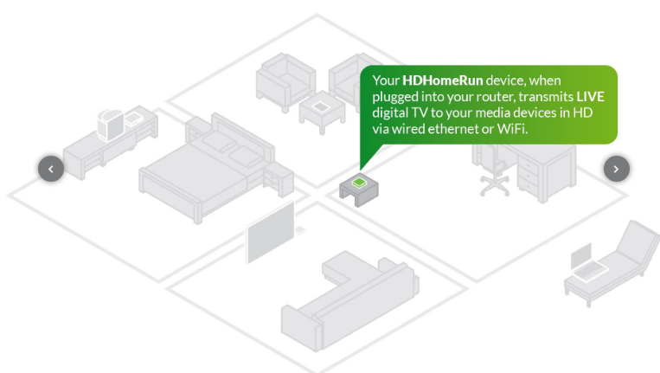
How it works

Slide 7
Startup Cost and “The Plan”
1 HD Homerun Prime (129)
1 Raspberry pi 2b, case, 16gb sd card, power - ~$60
1 cable card (4.95 / month)
Total, ~185
Changed nothing immediately. Picked up cable card from Verizon in Rockville down the road from Microcenter, where I picked up the hdhome run and raspberry pi.

Slide 8
HD Homerun Setup
Insert cable card
Wire to Ethernet
Load “disposable” HD Homerun Config program
Call Verizon and Activate cable card with code
Done!

Slide 9
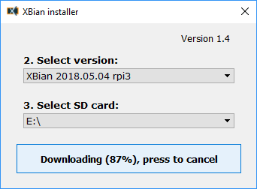
Xbian Setup / Configuration
Xbian.org has a great getting started page: http://www.xbian.org/getting-started/
Download Installer for your host OS from computer with SD card slot (Windows / Linux)
Reboot after installing installer (learned the hard way)
Pick correct raspberriy pi image and wait for download to start ( images for pi 1, 2 / 3 , 3B+)

Slide 10
Xbian Setup / Configuration 2
Licensing – rasperrypi does not come with MPEG2 or VC-1 license keys. MPEG2 (~$3)is required for HDHOMERUN. I’ve been buying the VC-1 key as well ($1.75)
You’ll need the raspberry pi serial number to buy the keys – it can be found in Kodi’s system information section
Buy the key from
http://www.raspberrypi.com/license-keys
After keys are emailed to you, add them in Kodi in settings -> xbian -> system

Slide 11
Other configuration
Calibrate video in settings -> system -> display (top left arrow)
Sync audio with video -> settings -> player
Allow Hardware Acceleration OMXPlayer -> settings -> player

Slide 12
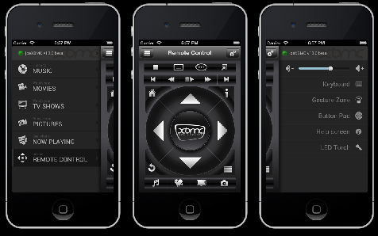
Remote
Kodi Remote (phone app)
CEC Tv Remote
mrRemote For Kodi (Windows)

Slide 13
Tips
Wired Ethernet is best for HD. SD works fine over 802.11n wifi, not 1080p
Get the appropriate sized power supply for your pi – it will likely run on lower power, but may or may not lock up
For extended periods of HD use (4+ hours), put a heat sink on the arm chip
4k does not work on a pi 3 or less hardware. Don’t know about p3b+

Slide 14
Hey, What about DVR?
Silicon Dust has a DVR program available
Write to a NAS over network, stream from any HDHomerun App
Client does not wake from sleep to record.
Tried to use FreeNas with AMD Trinity hardware. Very unstable.
Tried to use sandisk flash drives as boot volume
Need a whole separate session on free nas

